Slide 1
Travelling

Slide 2
Učebná pomôcka

Slide 3
OBSAH
Brainstorming
Reasons for travelling
Holidays
Sightseeing tour
Expressions for travelling
Means of transport
Travelling by land
Travelling by air
Travelling by water
Comprehension check

Slide 4
Hi! How did you get here?
I came by bus.
And Paul?
He missed the bus, so he had to take a taxi.

Slide 5
BRAINSTORMING
Write down all your thoughts about travelling that come into your head.
holiday
Travelling
car
bus
train
plane

Slide 6
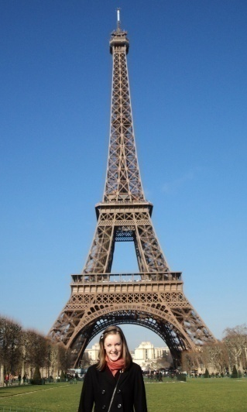
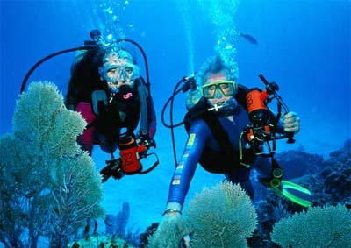
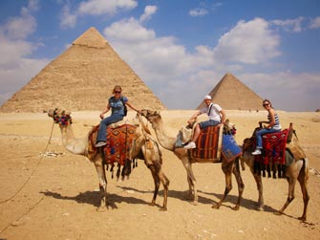
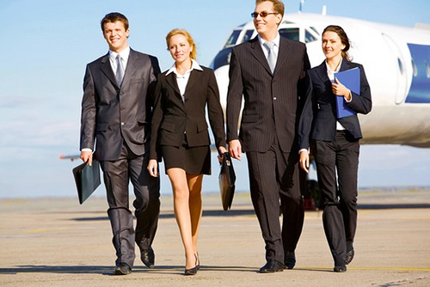
REASONS FOR TRAVELLING
People travel to school, on business or for pleasure.
They travel for political, cultural or scientific reasons.
They travel abroad on their holidays.
They want to see the most beautiful sights or places.

Slide 7
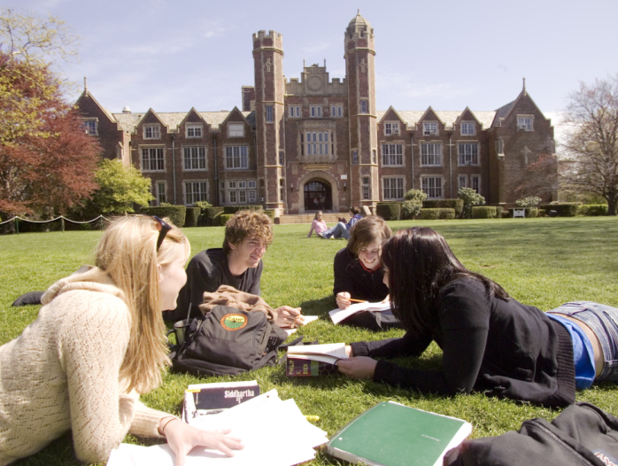
REASONS FOR TRAVELLING
They want to meet new people and friends, visit family, learn foreign languages, earn money, have fun, eat something unusual.

Slide 8
HOLIDAYS
People go on holiday to relax, to experience a new culture, to visit new places or for adventure.
holiday = vacation
Where did you go on your last holiday?

Slide 9
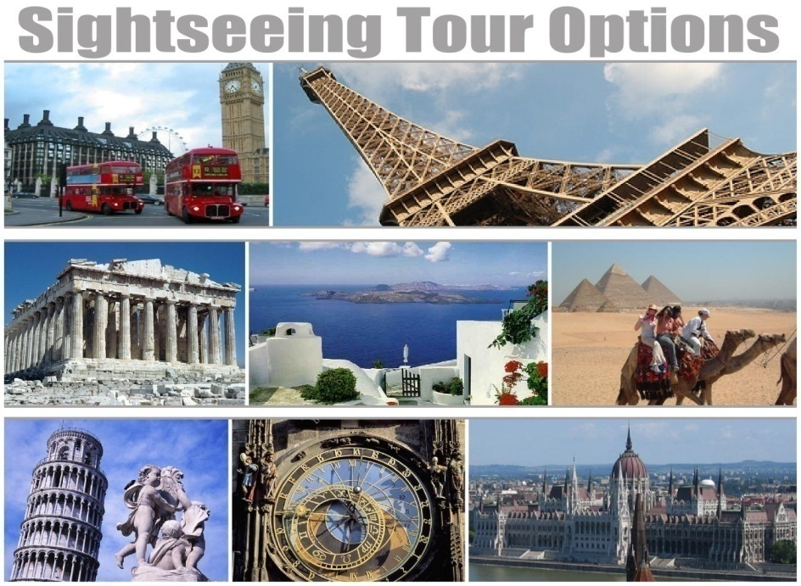
SIGHTSEEING TOUR
You may go on sightseeing tour on your holiday. You will probably go to a museum or art gallery, and see or visit some castle, temple, cathedral, market, statues, fountains or palace.

Slide 10
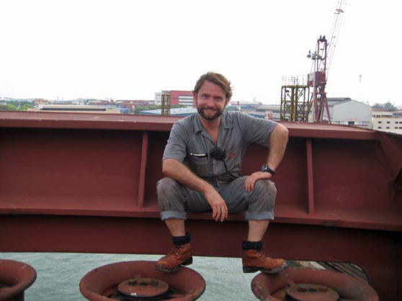
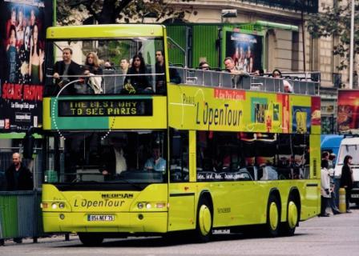
EXPRESSIONS FOR TRAVELLING
TRIP – a journey from one place to another
VOYAGE – a long journey by boat, ship to a distant place or expedition from one place to another by land
TOUR – a long journey including the visiting of a number of places, a brief trip through a place, as building or a site

Slide 11
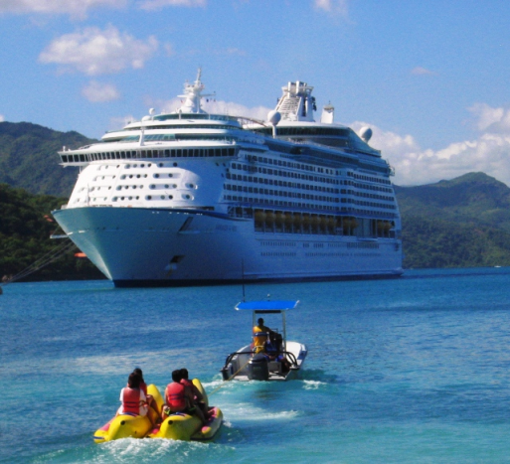
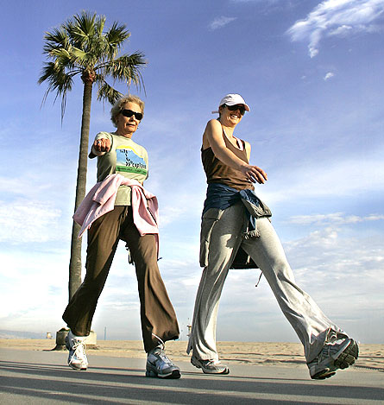
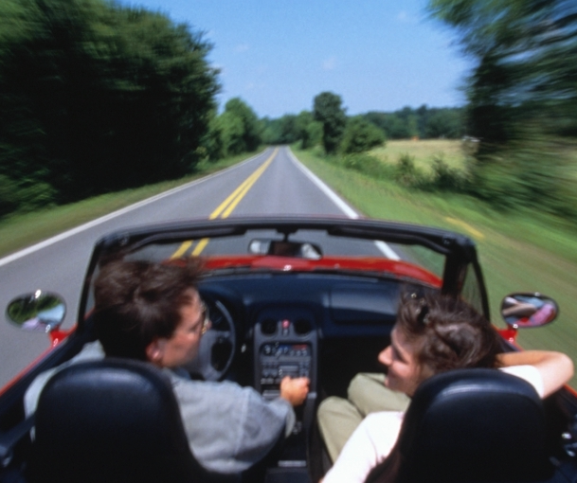
EXPRESSIONS FOR TRAVELLING
CRUISE – a sea voyage for pleasure
TRAVEL – an act or process of traveling; movement from one place to another.
WALK - a journey on foot
DRIVE – a journey by car

Slide 12
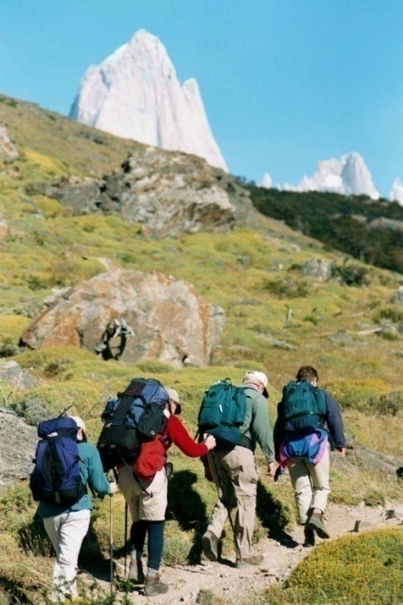
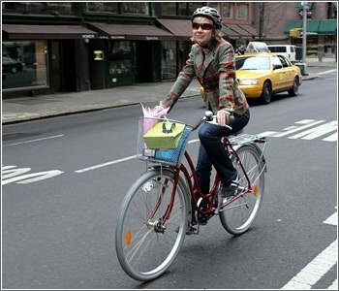
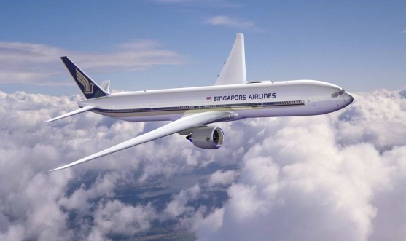
EXPRESSIONS FOR TRAVELLING
RIDE – a journey by bus, train, bike etc.
FLIGHT – a journey by plane
HIKE – a walk in the mountains or countryside

Slide 13
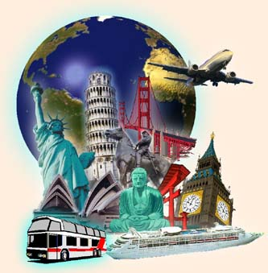
MEANS OF TRANSPORT
People can use their own means of transport or they can rely on the public transportation services.
People and goods can be transported by land, by air or by water.

Slide 14
TRAVELLING BY LAND
BICYCLE/ BIKE
MOTORBIKE/ MOTORCYCLE
CAR
VAN
LORRY
TRAIN
BUS
COACH
UNDERGROUND
Travelling by land – means of transport

Slide 15
TRAVELLING BY LAND
Useful expressions:
Can I have a single/return ticket to Barcelona?
I would like to book/reserve a seat in advance.
How much is the bus fare?
The Edinburgh train departs/leaves from platform 6.

Slide 16
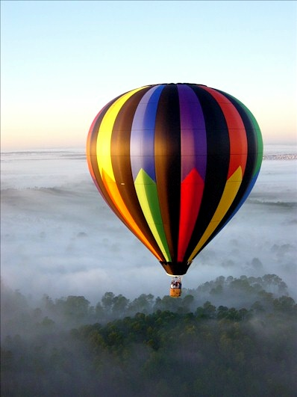
TRAVELLING BY AIR
PLANE
HELICOPTER
HOT AIR BALOON
ZEPPELIN

Slide 17
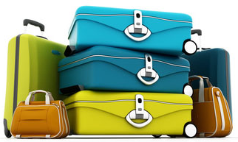
TRAVELLING BY AIR
Useful expressions:
You have to check in an hour before the plane takes off.
I went through customs but nobody checked my passport.
Give your boarding card to the flight stewards when you get on the plane.
The plane landed in New York at 5.30.
Have a good flight.
baggage/ luggage

Slide 18
TRAVELLING BY WATER
BOAT
MOTORBOAT
SHIP
SAILING SHIP
CRUISE SHIP
FERRY
YACHT
Travelling by water

Slide 19
POUŽITÁ LITERATÚRA
English vocabulary in use - elementary, Michael Mc Carthy, Cambridge 2005
English vocabulary in use – pre-intermediate and intermediate, Cambridge, 1997
Friendship, 9-10, 2004
http://en.islcollective.com/worksheets/worksheet_page?id=5008
http://esl.about.com/od/vocabularyintermediate/a/v_travel.htm
http://www.sme.sk/c/5503439/anglictina-na-leto-je-to-lepsie-by-plane-alebo-by-train.html

Slide 20
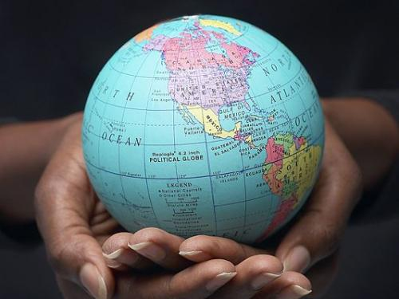
THANK YOU
FOR YOUR ATTENTION ☺

