Slide 1
Human relationships

Slide 2
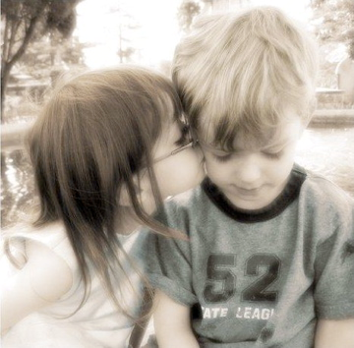
What do human relationships mean?
the way that people behave/act towards each other, what they feel about each other
How can HR be divided?
- good and bad
- formal and informal

Slide 3
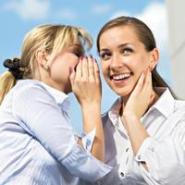
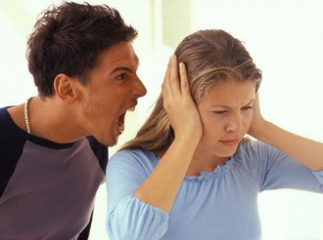
Good and bad Relationships
We have good relationships
if we love, undestand each other, get on with each other
bad relationships - argue, are angry with, dislike or hate each other

Slide 4
Formal and informal relationships
Formal r. – can be between employers and employees, students and teacher
Informal r. – parents and children, husband and wife – it means relationships within families or between friends etc.

Slide 5
How do HR change as we grow older ?
1st relationships are formed in our families – parents and children. It is very important relationship which can influence us during the whole life. We should have good relationship with our parents – should be our examples.
Relationships in families are complicated nowadays.
Parents – busy, tired, don´t have enough time, live stressful life.
If parents and children don´t understand each other there is a generation gap in families.

Slide 6
How do HR change as we grow older ?
Later we look for friends – usually the people with the same values. Some friendships can last your whole life. Some can be short –termed.

Slide 7
Qualities of a true friend
Explain : „A friend in need is a friend indeed.“
Friends or acquaintances
Friends are people we spend lots of time with, we have much in common
Acquaintances – people who we know, but who are not close friends.
- he / she should / shouldn´t ....

Slide 8
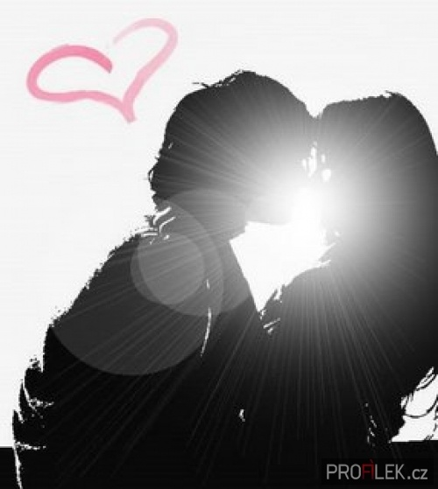
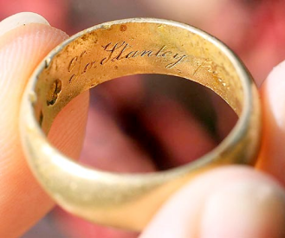
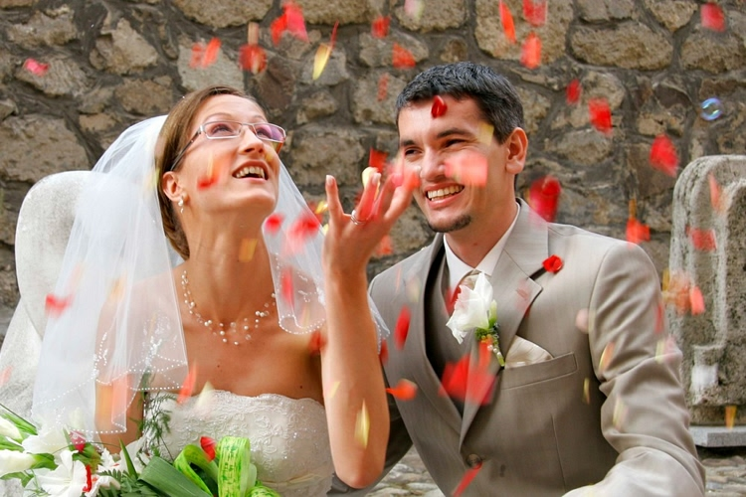
How do HR change as we grow older ?
When we are older we have a romantic relationship. A boy and a girl fall in love, start dating, later get engaged and get married.
Nowadays many marriages break up/split up. There s a high divorce rate.

Slide 9
When is a marriage happy?
What is neccessary?
to love each other
to spend time with
a family
to share duties /
responsibilities
to have common
interests
to talk about problems
mutual understanding
and respect

Slide 10
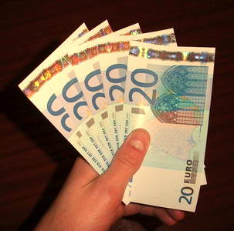
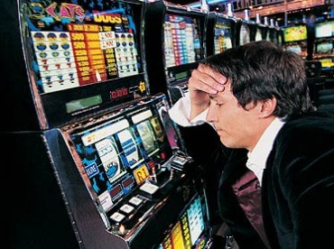
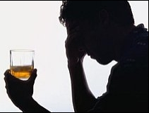
Reasons for a divorce
lack of communication between spouses
infidelity
alcoholism
drug addiction of one of spouses
gambling
financial problems

Slide 11
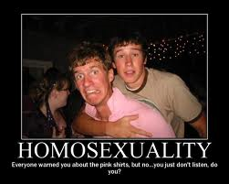
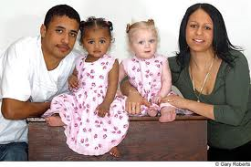
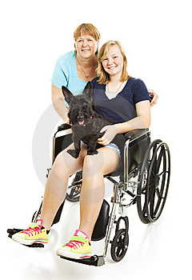
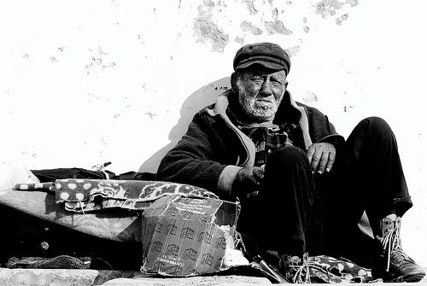
Problems of „different“ people in our society
Society often faces problems between people of different races, religions, social classes or the disabled.
Reasons of negative relationships
illiteracy
predjudice
close – mindedness
intolerance
people are suspicious

Slide 12
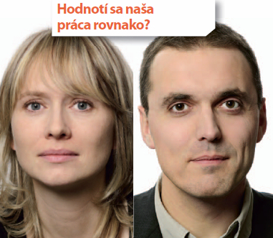
Status of women in society
The relationship between men and women in society was different from the present one. In the past women couldn´t get good education, couldn´t work or vote. The women´s movement tried to change it. Nowadays it has got better. Women and men should be treated equally – at home or at work.

