Slide 1
Maturitné témy
HOUSING

Slide 2
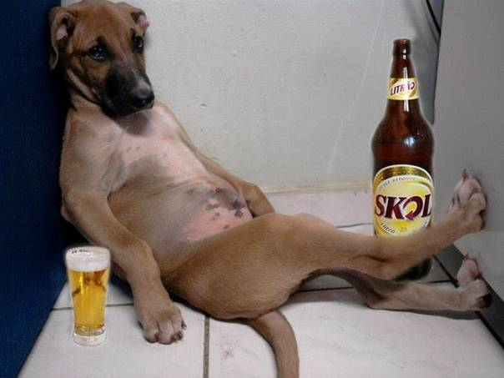
Home is a place where your heart is….
Wazz up?
I have bustered.

Slide 3
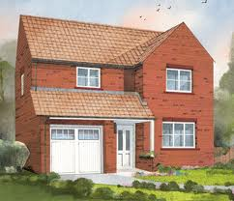
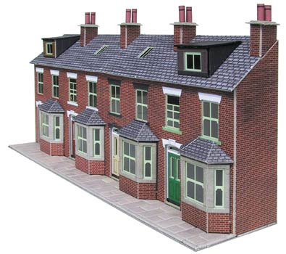
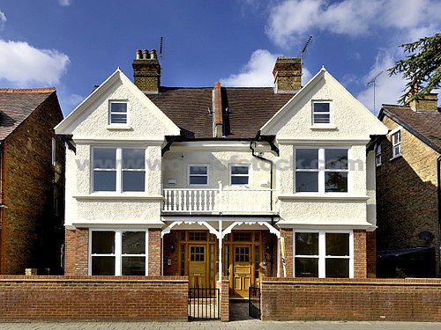
TYPES OF HOUSES IN GREAT BRITAIN
Terraced house, which is build in a row.
Detached house
that stands by itself
Semi-detached house
has one common wall

Slide 4
Picture describing
roof
window
grass
drive
path

Slide 5
your future room.

Slide 6
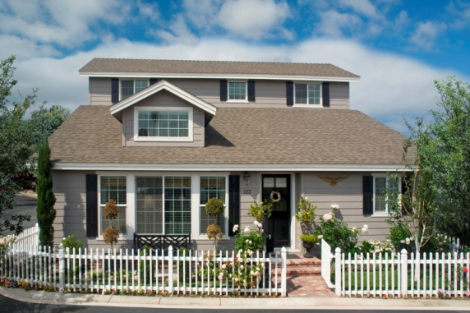
Tell us about your home
Describe the type of house you live in.
I live in a detached/semi-detached house/farm house/….
It is ….year {s} old and has….rooms.
Our place includes an attic/ a cellar/….
___________________________________________________
I live in a terrace-house/block of flats/housing estate/…..
It has…..floors and…..flats.
There are also balconies/garages…..

Slide 7
Briefly describe the rooms in your home
In the kitchen we have a sink/fringe/stove… and a pantry.
In the living room, there is a /sofa,/ coffee table/Hi-Fi system/settee/wall unit/ on the floor there is a patterned carpet
My room has a desk/ lamp/rug/ bed …..
In the bedroom, there is a double bed/ bedside table/dressing table…
Our hallway has a mirror/ closet/ coat-rack….
Generally, I feel at my home comfortable and cosy.

Slide 8
Does your family have a garden?
We have a small/medium-sized/large garden with….fruit trees and ….flower-beds.
We also grow vegetables, such as carrots/garlic/onions/lettuce and fruit, such as black currant/ red currant/ gooseberries/ strawberries/ cherries/ raspberries….
Unfortunatelly, we have not got a garden next to our flat.
We have a garden in our summer cottage in…. There we grow…..
We have a small garden about…km from our home.
We have not got any garden, we live in a town.

Slide 9
Living in the town –advantages
There are many possibilities for jobs, education, sport and social life
There are many cultural events there, such concerts, operas and theatre performances
People can visit cafés, pubs and night clubs
There are many shops and hospitals too
People are anonymous

Slide 10
Living in the town –disadvantages
People live in noisy, polluted and crowded places
There also a lot of mess in the streets
High level of criminality
There is lack of parking spaces
There is lack of green
People can not breed farm animals, just only keep pets
Polluted air

Slide 11
Living in the village –advantages
There is unpolluted air, people live in the fresh air
There are cheaper houses and more space
There is a lot of grass and closer to the forest
People can pick up wild fruit and mushrooms
There is quite, peace
People are friendly and helpful
There is a lot of folk tradition, such as folk dances, carnivals and folk festivals

Slide 12
Living in the village –disadvantages
Each knows about each other, people are not anonymous
There is far from public transport, having car is necessary
There are few shops, no shopping malls,
There is far from cinemas and restaurants
There are a lot of pubs
Few job opportunities

Slide 13
HOMELESS PEPLE
I feel so alone and I am cold.
Homeless people are without home, they have no money, family, friends, work, food, some of them can’t have a work, but some can but don’t want. They are used to their way of life, they don’t want to change it.

Slide 14
FLATS

Slide 15
Discussion

Slide 16
TESTY HOT POTATOES
Doplňovačka
Priraďovačka

