Slide 1
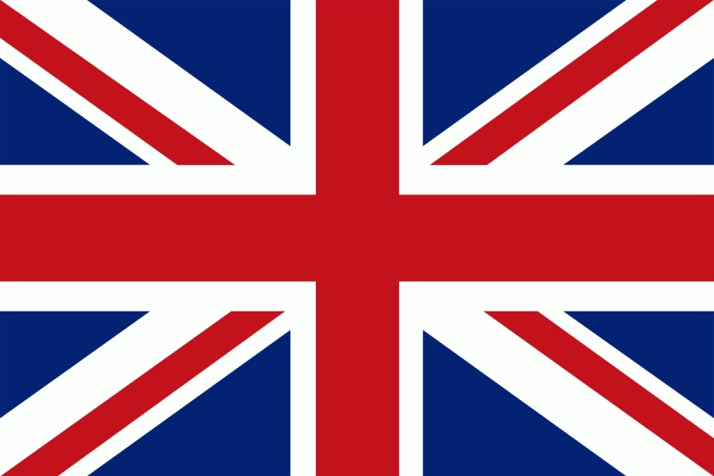
Some facts about Great Britain
Maturitná otázka
Notes:
otá

Slide 2
General Information
Great Britain consists of England, Wales and Scotland, while the United Kingdom also includes Northern Ireland.
population is about 59 million inhabitants
official language is English
the large is about 240. 000 km²
currency is 1 pound = 100 pence
Head of the state is The Queen Elisabeth II
national anthem is God Save the Queen

Slide 3
God Save the Queen National Anthem
God save our gracious Queen, Long live our noble Queen, God save the Queen! Send her victorious, Happy and glorious, Long to reign over us; God save the Queen!
2. O Lord our God arise, Scatter her enemies And make them fall; Confound their politics, Frustrate their knavish tricks, On Thee our hopes we fix, God save us all!

Slide 4
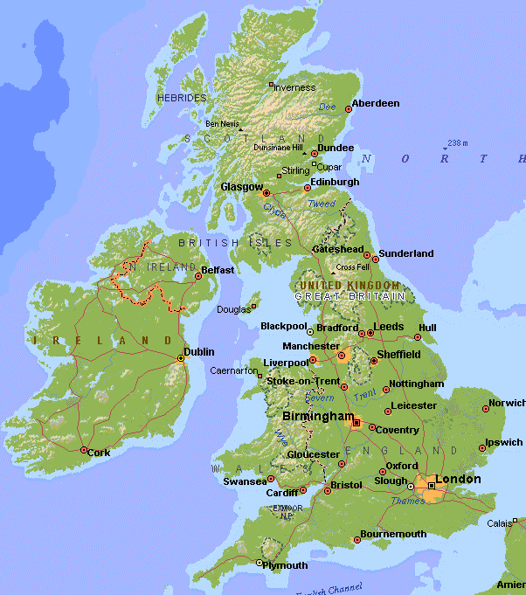
Map of Great Britain and Capital Cities
Scotland
Edinburg
England
London
Wales
Cardiff

Slide 5
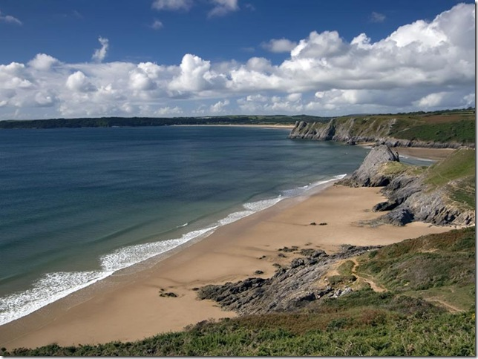
Geography and nature
Britain is situated on the British Isles lying on the Northwest Coast
of Europe
it is bordered by the Atlantic Ocean on the northwest, on the north is
bordered by the North Sea and on the southwest is separated from the European continent by the English Channel.
Britain is a beautiful country with many places of interest, attractive
countryside.
the rivers are not very long, but deep. The best known river is
Thames{flies through London}
the largest lake in the British Isles is Lough Neagh in Northern Ireland
there are very few forests in Britain and a lot of moors.
the highest mountain is Ben Nevis{1343 m above sea level} in the Scottish Highlands

Slide 6
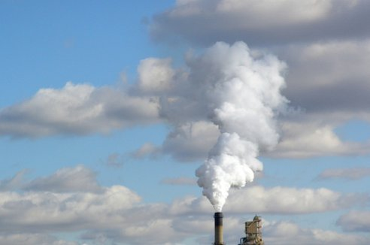
INDUSTRY
Britain is very rich in coal
the industry is highly developed
it comprises iron and steel engineering, textiles, plastic, electronics, wool, shipbuilding and food products
the most important industry towns are Newcastle, Manchester and Liverpool

Slide 7
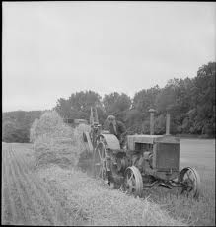
Agriculture
The chief agricultural products are wheat, barley, oats, potatoes, sugar beat, milk and meat.

Slide 8
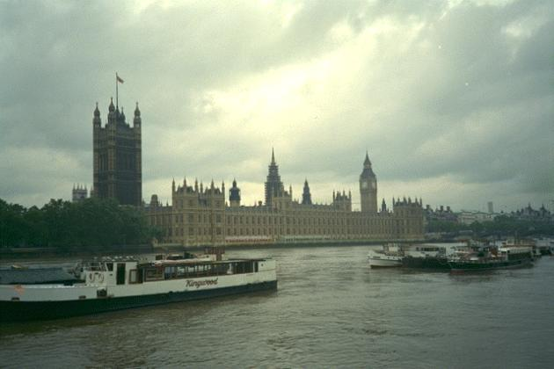
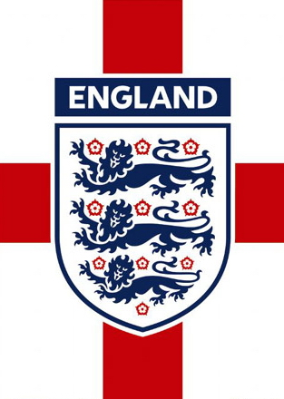
ENGLAND
occupies the largest, southern part of Great Britain.
the capital city is London
it has about 49 million inhabitants
The country is divided in 39 counties Yorkshire, Kent, Essex
The principal mountains are the Pennines, called Backbone
The countryside is remarkable for its green fields
England has a very rich architecture and a long coastline

Slide 9
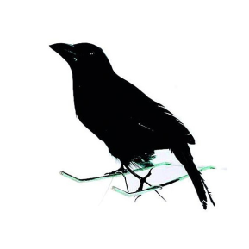
LONDON the most beautiful monuments The tower
In the past it used to be a fortress, a royal palace, a royal mint and a prison
Many famous people were imprisoned and executed there
Nowadays, there is a museum of arms
There is an exhibition of weapons, the Crown Jewels are kept there
There is a legend saying about six ravens that house here to protect the UK and if they leave, it will stop to exist.

Slide 10
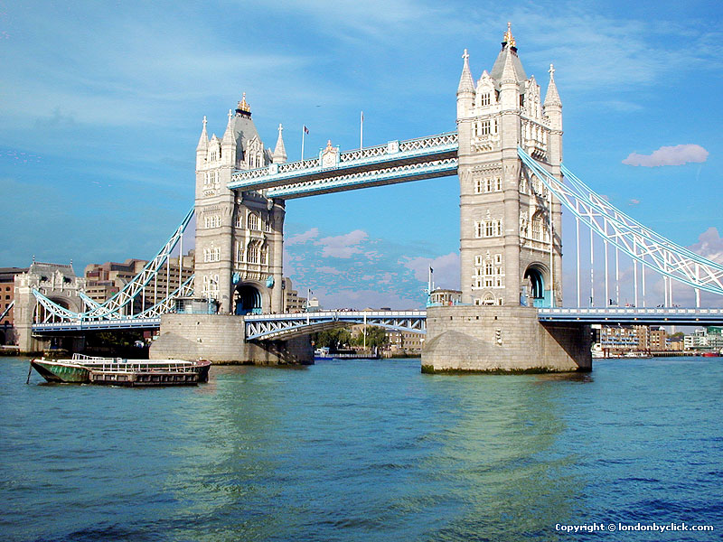
The Tower Bridge
it is one of the most famous symbols of London
it stands next to the Tower
it has two towers with a high of 65 meters
it is openable in the middle to allow ships pass up the river

Slide 11
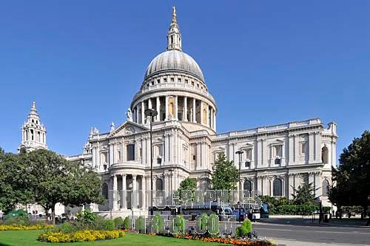
St Paul’ s Cathedral
it is one of the largest cathedrals in the world
it was built by Sir Christopher Wren
inside is the Whispering Gallery
famous British people are buried here e. g. Admiral Nelson
Prince Charles and Lady Diana were married here in 1981

Slide 12
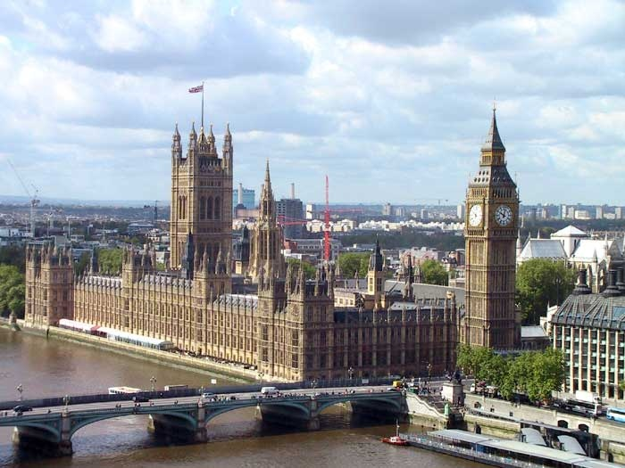
The House of Parliament
it is the seat of the British Parliament
it contains of the House of Commons and the House of Lords

Slide 13
BIG BAN
the official name is the Big Ban Tower Clock
it is not the name of the bell, but of the clock
it is named after Benjamin Hall
it is famous for its accuracy
The most famous symbol of Britain

Slide 14
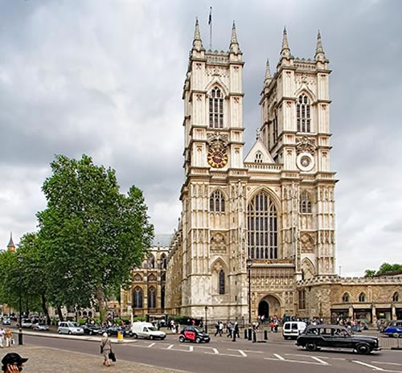
Westminster Abbey
it has been the coronation place of almost all English kings
there is also Poet’s Corner, where are the tombstones of British famous poets {Walter Scot, Lord Byron}

Slide 15
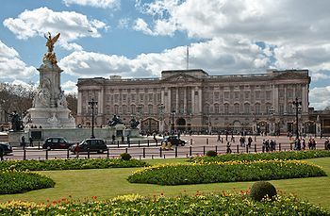
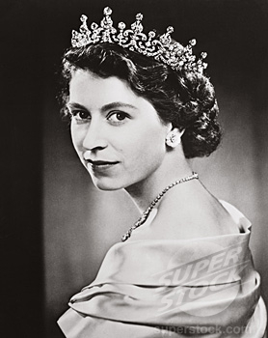
Buckingham Palace
it is the residence of the Queen Elisabeth II
the ceremony of changing of the guards is seen every morning at about 11: 30 a. m.
the royal flag is flown when the Queen is in the residence

Slide 16
WALES General information
the capital is Cardiff
the oldest son of the Queen and the successor of the English throne is given the title Prince of Wales
two languages are spoken here English and Welsh
it’s famous for its long rivers, big lakes and high hills
it is very rich in culture and history
the Welsh people love music and poetry
popular is festival of choral singing

Slide 17
SCOTLAND
the capital is Edinburg
it is situated to the north of England
wonderful country, full of traditions and cultural life
own system of education
there are more than 5 millions inhabitants
there is the highest peak of England Ben Nevis
the country of hills, lakes, swift rivers and deep valleys

Slide 18
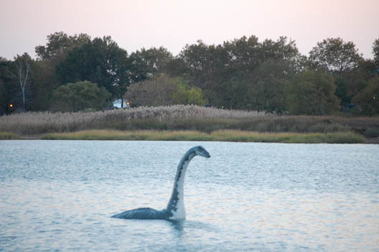
LOCH LEMOND
The most famous lake in Scotland is Loch Lemond where the monster Loch Ness lives

Slide 19
Loch Lemond Song

Slide 20
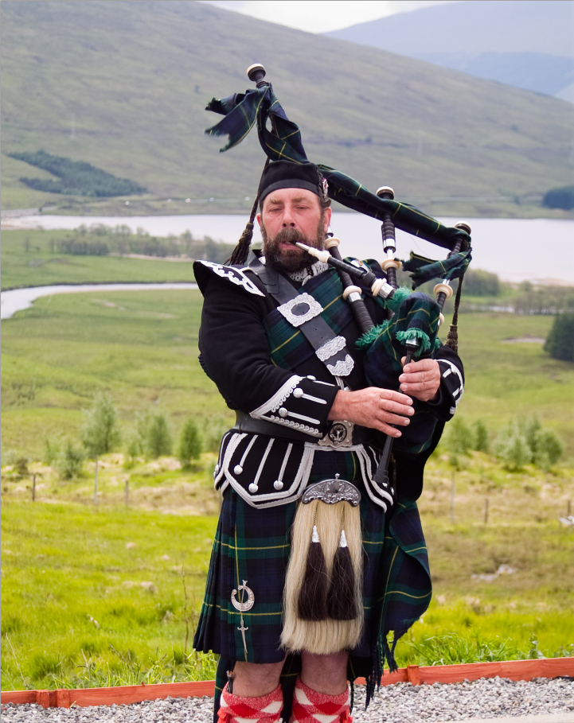
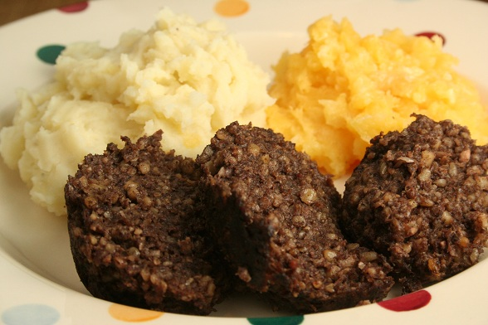
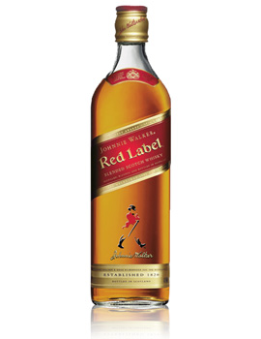
The most famous symbols of Scotland
Scottish Cooking
Peace and plenty; and no killing; Beef at a groat, and meat at a shilling. Whisky for nothing, beer at the same. A bonnie wee wife; and a cosy wee hame.
The most popular Scottish meal huggis
There is a special tradition of playing bagpipes and wearing kilts, which are typical knee-length pleated skirts
The Scottish whisky is the most famous drink

Slide 21
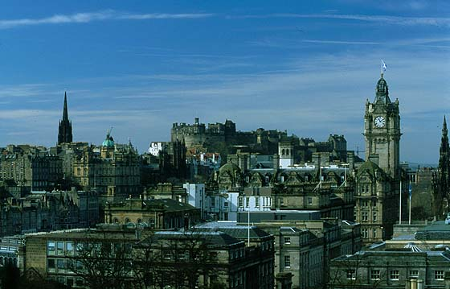
EDINBURGH
it is the capital of Scotland
it is one of the most beautiful cities in the world
it has become the international centre of music and drama

Slide 22
English speaking countries
Maturitná otázka č. 24

Slide 23
Thank you for your attention

